Slide 1
Fit or Fail a revolutionary fitness game
Travis Stewart
Christian Sauls
Josh Shevitz

Slide 2
Purpose of The Game
Purpose
To create a fun/interactive learning experience for all teens to educate on healthy lifestyle choices
Beginning with high school aged kids
Eventually expending to all school aged kids
US Dept of Health and Human Services (DHHS) – “teens today are more likely to develop a sustained interest in a healthy, active lifestyle if they are provided with some type of technology-based “game-like” tool to stimulate their interest in the areas.“

Slide 3
About Our Game
Our game will be a trivia style game
Internet availability:
Local – play using only your device
Supported modes: single player
Online – play people from anywhere around the U.S.
Supported modes: single player, team
Two modes:
Single player mode
Team mode

Slide 4
Tools and Technologies Used
Languages
Frontend/client side:
HTML and CSS
JavaScript (ReactJS)
Backend/server side
SQL
Web Host platform/service
www.name.com
APIs
Type here

Slide 5
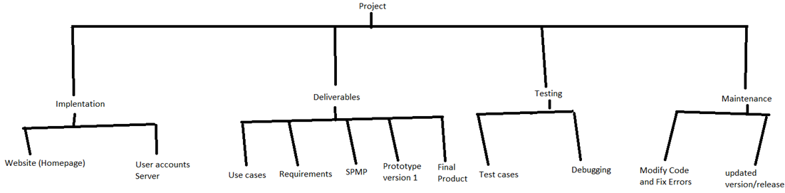
Work Breakdown Structure

Slide 6
Work Completion Timeline

Slide 7
Completed Tasks
Task | Who Completed
GitHub Setup | Josh
Use Cases/Requirements | Josh/Christian
Gantt Chart | Travis
SPMP | Travis, Christian
Technical Status Presentation | Travis
Integration/Unit Testing Skeleton
Website/Game Development | Josh, Travis
Project Review | Travis,

Slide 8
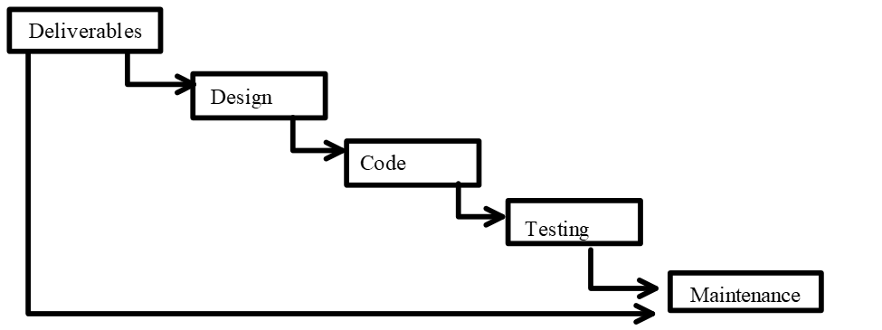
Process model
This project will be using the waterfall model
Has many phases/part
Each part relies on the previous parts
Waterfall model parts (in order)
Requirements Analysis
Design
Implementation
Verification/Testing
Maintenance.

Slide 9
Website game layout

Slide 10
Current Working Prototype

Slide 11
Code Review

